Slide 1

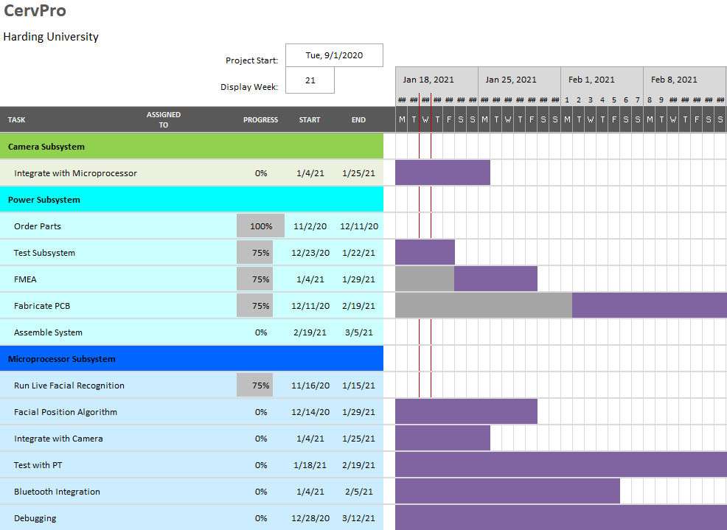

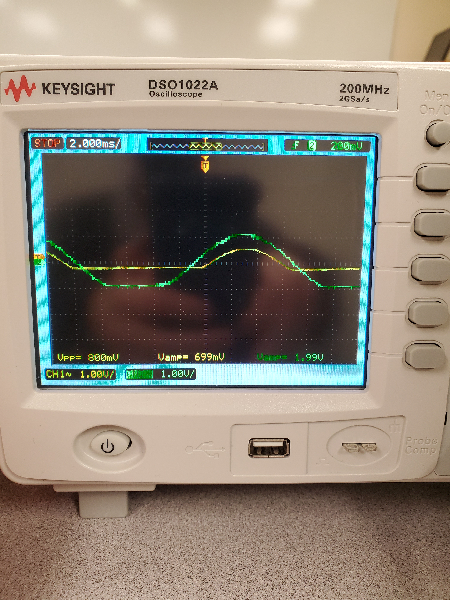
CervPro
Cervical Proprioception Diagnosis: A3 Status
Date: January 21, 2021
Members: Nathan Vielmette, Ethan Grimes, Keneth Chelelgo, and George Cook
Background
PT cervical proprioception (CP) assessments are subjective and determined by PT opinion.
Motivation is to create device that gives PTs objective data that shows patients’ ability to sense head and neck position in space.
Device will sense head position and angular velocity.
Proposed Countermeasures
Contact Plybon
Creative spot soldering and testing individual components before integration
Start comparing newer versions (v4.4 or higher) for dlib compatibility
Use provided solidworks housing files and existing component files to perform thermal finite element analysis
Current Conditions
Recent Results
Validated transformer step-down and impedance characteristics
Changed diode components to meet needed current specs
Fixed floating ground error
Validated two functional groups together
Began setting up Jetson Nano microprocessor
Far cheaper to purchase off-shelf housing than to 3D print
Housing selection narrowed down to 2 or 3 options
Goals/Targets
Use of device will be faster than double standard CPE test time
Patient will not need to touch any part of device
Accurately measures head position and speed within 5% error margin
Device will be move and <10lbs
Analysis
Choosing Protomat vs. Outsourcing PCB
Testing components with nonstandard packaging
Resources for setting up Jetson Nano are out of date and partially incompatible with dlib (v4.2)
Unsure if the chosen off-shelf housing will present thermal or mounting problems
Next Steps
Finish component testing and print PCB (Nathan)
Learn how to make a new CMake List file (George)
Set up Jetson Nano for v4.4 (George)
Start testing example program for facial recognition compatibility (George)
Ensure thermal load on housing is not a problem and order housing (Ethan)
Begin brainstorming how to test cooling capabilities of ICE tower (Keneth)

Slide 2
CervPro
Cervical Proprioception Diagnosis: A3 Status
Date: January 21, 2021
Members: Nathan Vielmette, Ethan Grimes, Keneth Chelelgo, and George Cook

Slide 3
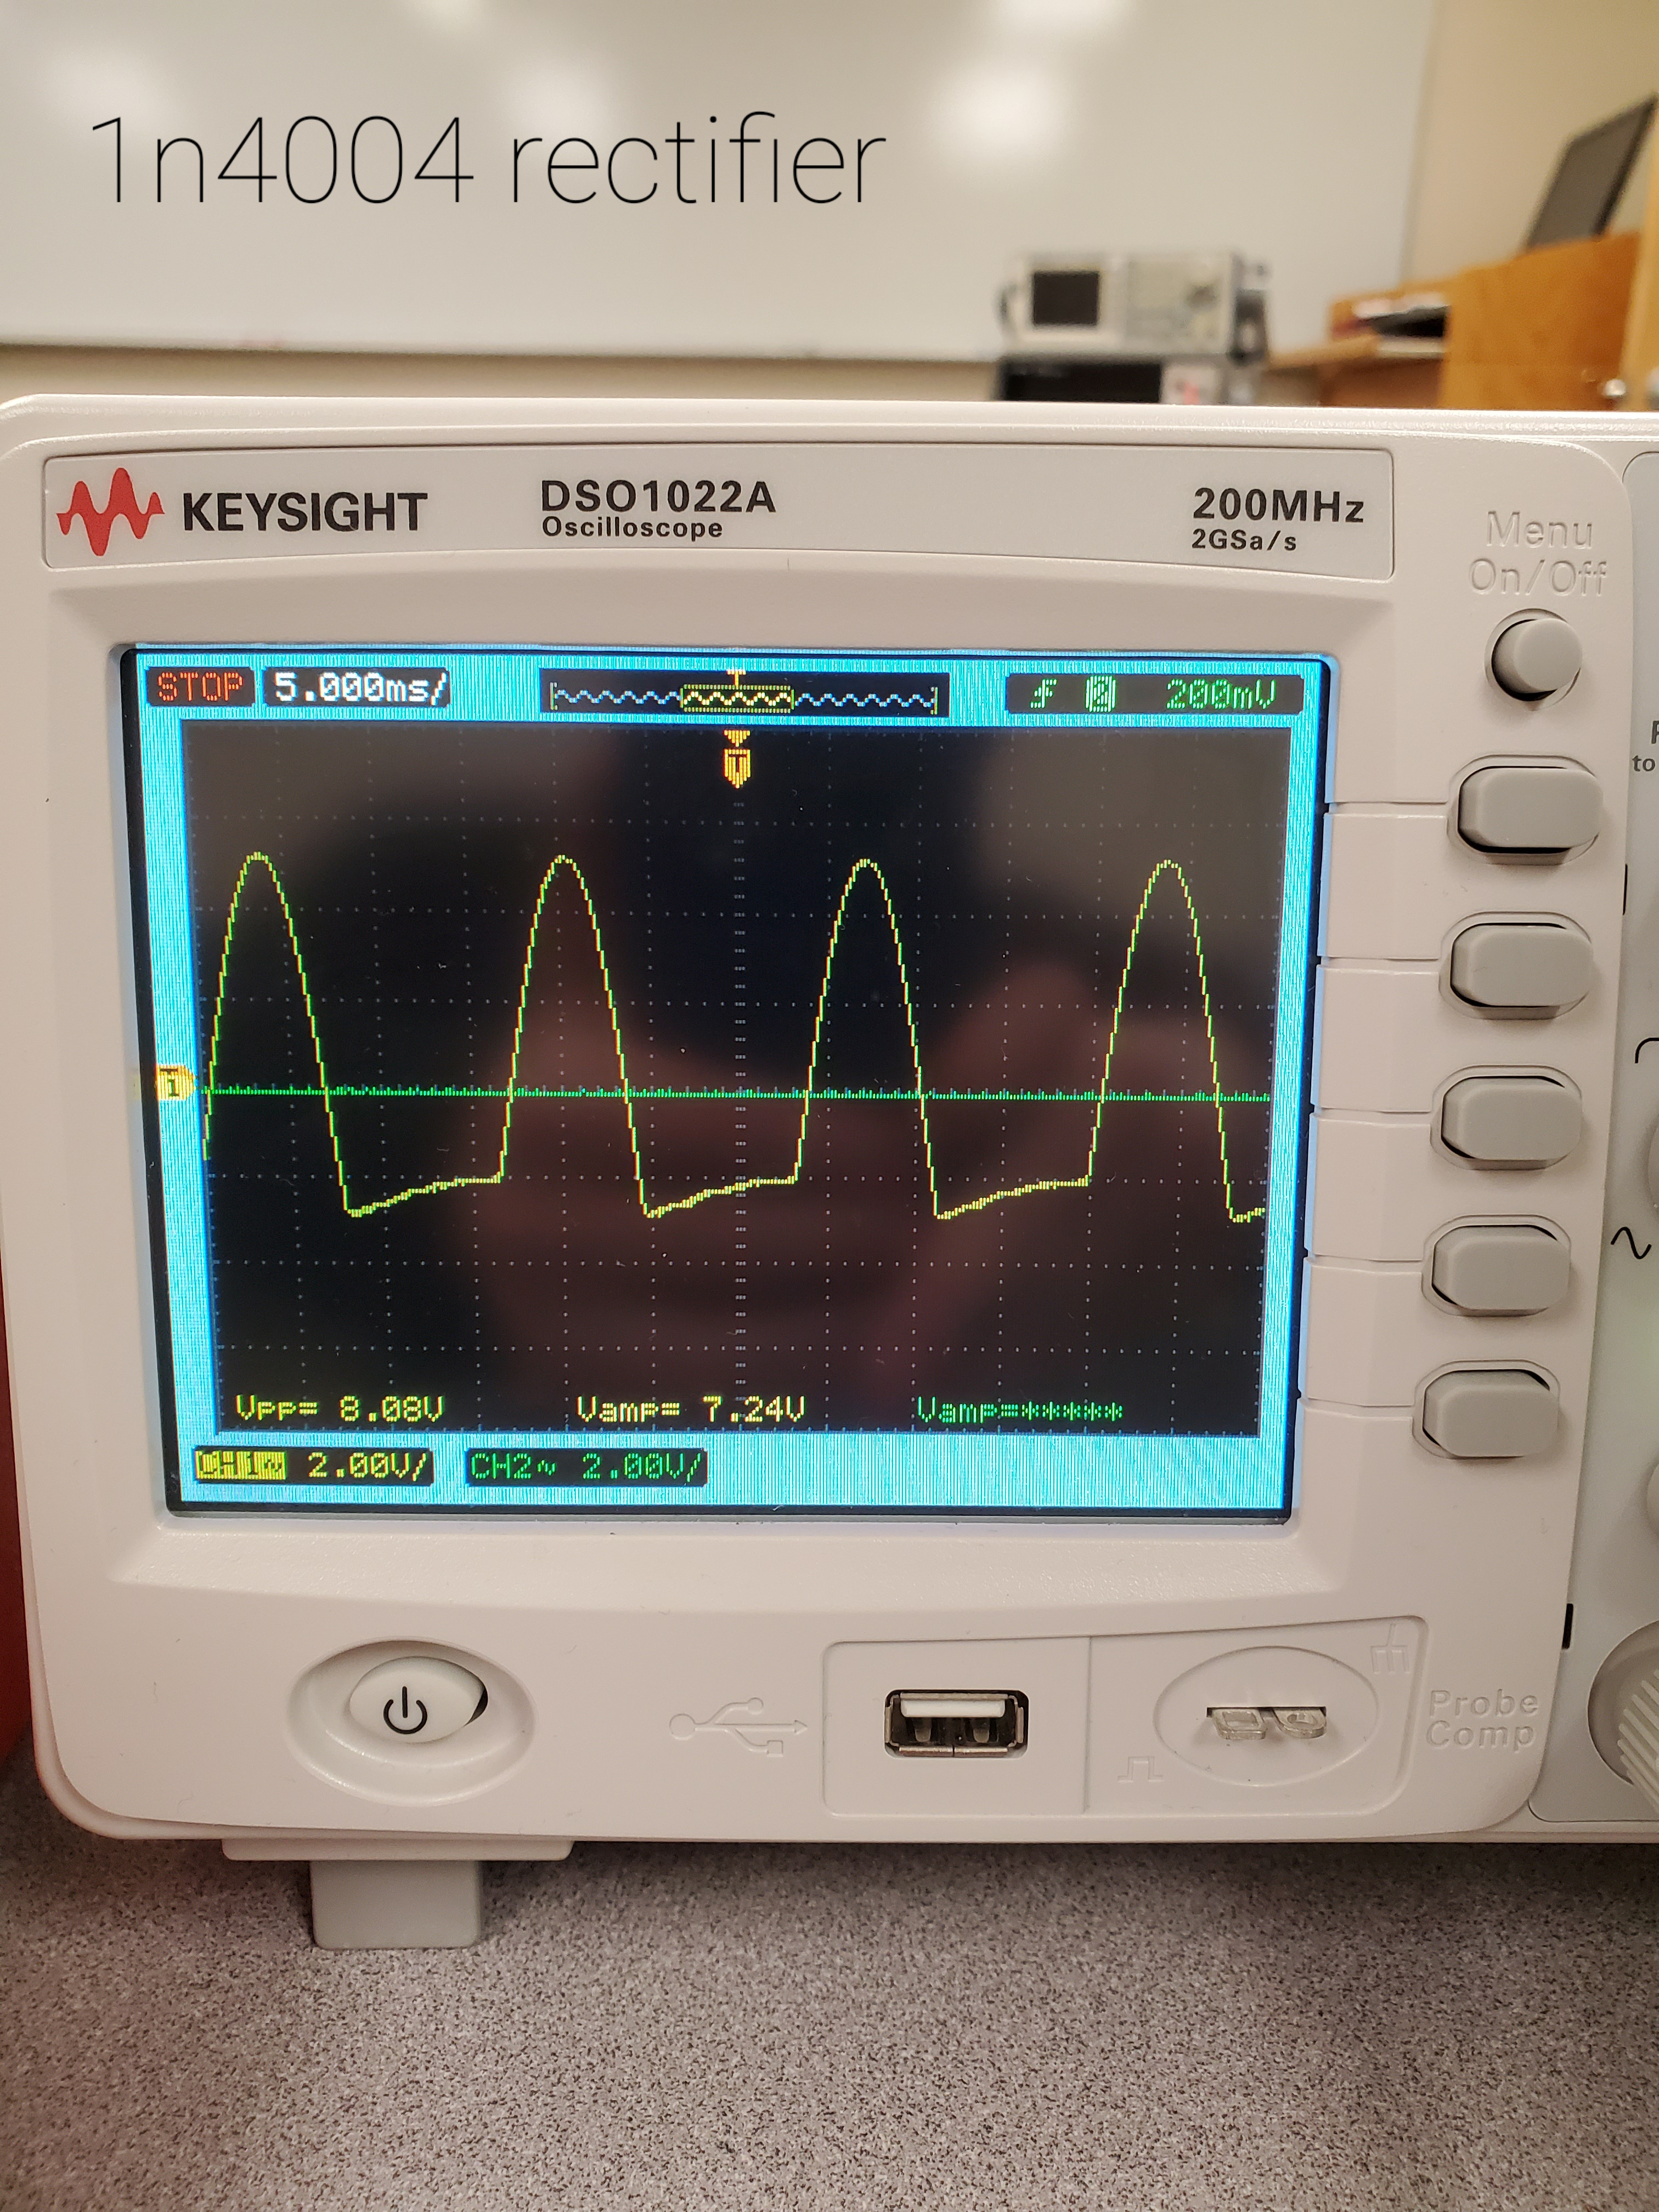
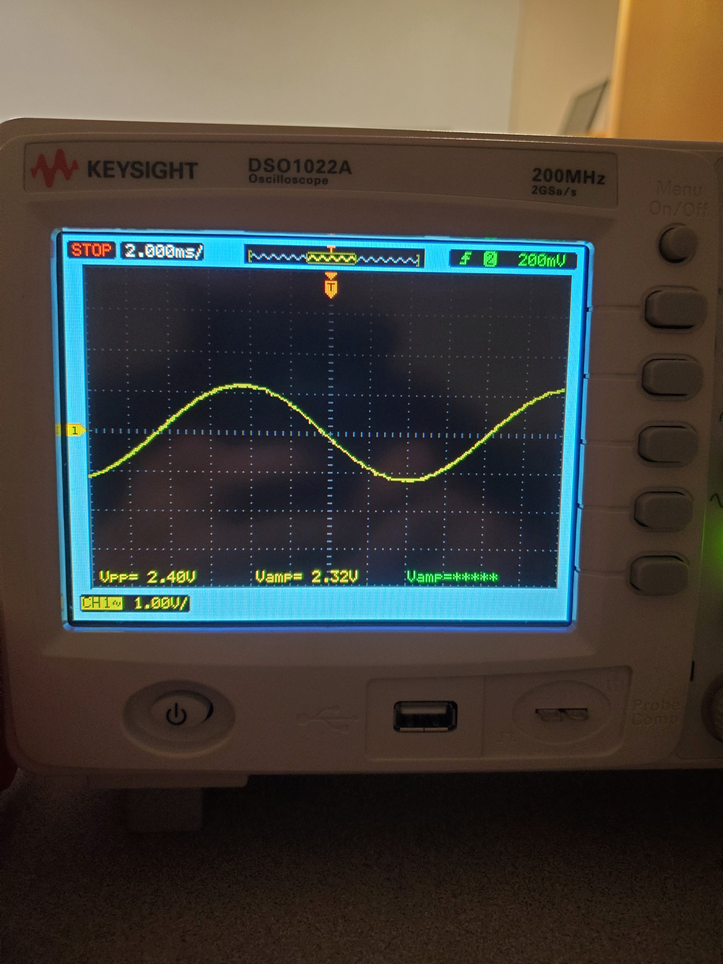
CervPro
Cervical Proprioception Diagnosis: A3 Status
Date: January 21, 2021
Members: Nathan Vielmette, Ethan Grimes, Keneth Chelelgo, and George Cook
Validated transformer step-down and impedance characteristics (left)
Changed diode components to meet needed current specs and validated (right)

Slide 4
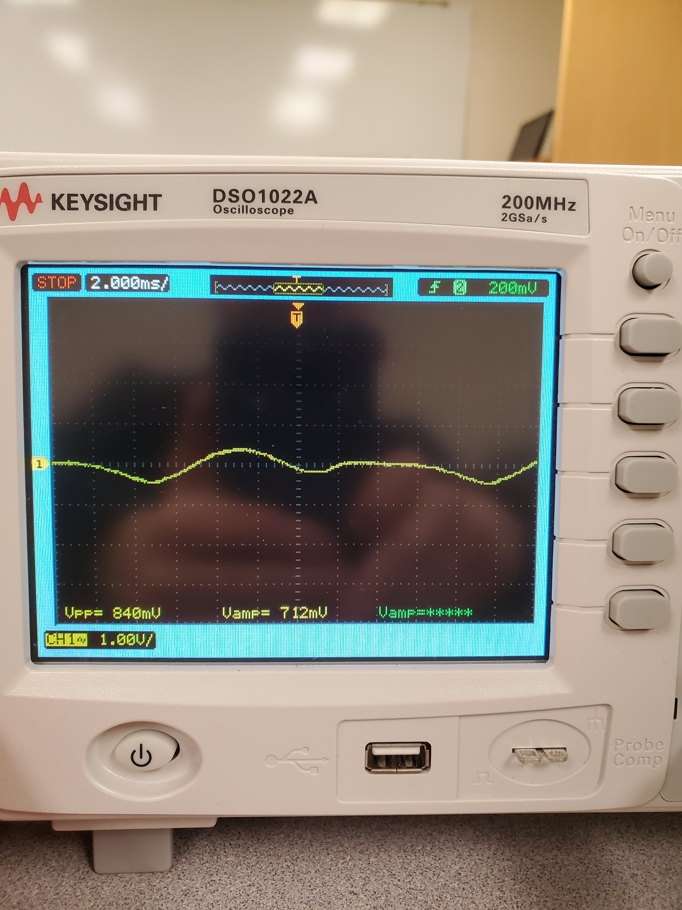
CervPro
Cervical Proprioception Diagnosis: A3 Status
Date: January 21, 2021
Members: Nathan Vielmette, Ethan Grimes, Keneth Chelelgo, and George Cook
Fixed floating ground error (left)
Validated two functional groups together (right)

Slide 5
CervPro
Cervical Proprioception Diagnosis: A3 Status
Date: January 21, 2021
Members: Nathan Vielmette, Ethan Grimes, Keneth Chelelgo, and George Cook

Slide 6
CervPro
Cervical Proprioception Diagnosis: A3 Status
Date: January 21, 2021
Members: Nathan Vielmette, Ethan Grimes, Keneth Chelelgo, and George Cook
Validated transformer step-down and impedance characteristics (YL output, 2nd file)
Changed diode components to meet needed current specs and validated (rectified YL output, 3rd file)
Fixed floating ground error (goofy looking signal, 4th file)
Validated two functional groups together (half wave rectified YL output and transformer output GN, 1st file)

Slide 7
CervPro
Cervical Proprioception Diagnosis: A3 Status
Date: January 21, 2021
Members: Nathan Vielmette, Ethan Grimes, Keneth Chelelgo, and George Cook
George’s Progress (1-20-21)
Over break I found some useful examples in dlib that may help in the process of developing the system,
and also started looking into Google Firebase which may help in the mobile app development and add
the ability to have a pc option (not that certain about all of this).
Roadblocks
The most useful of the examples was not built by CMake when the rest were. I am looking into how to
make a CMake List file to try and build it.
The guide for setting up the Nano was out of date (based on version 4.2) and we need version 4.4 or
better (I do not know if there is a higher version or not) to be able to use dlib at maximum efficiency and
without workarounds. I have found where to get version 4.4 and will use the guide a bit more leniently
knowing that some things are out of date and that they may work differently on the newer version.
Recent results
I had started the process with version 4.2 and was about halfway through the setup processes, but then
I found the problem with version 4.2 not being fully compatible with dlib.
Next steps
I will learn how to make a CMake List file and make a new one to run the example.
I will set up the Nano running Jetpack version 4.4
I will start testing the example program to see if that facial detection algorithm will work for us.

